Slide 2
Substance Abuse Treatment section

Slide 3
Objective
Understanding Section substance abuse and treatment
Understand the substance abuse and treatment section Specific Guideline & Coding Tips
Clinical examples for better understanding
Knowledge Check

Slide 4
Definition
There are 7 types of procedure performed in this Section.
Detoxification Service : Detoxifiction from alcohol and or drugs
Individual Councelling : The application of psychological methods to treat an individual with addictive behavior
Group Councelling:The application of psychological methods to treat 2 or more individuals with addictive behaviour
Individual Psycotherapy : Treatment of an individual with addictive behavior by behavioral, cognitive,psychoanalytic,psychodynamic,or psychophysiological means
Family Councelling: The application of psychological methods that includes one or more family members to treat an individual with addictive behavior
Medication management: Monitoring and adjusting the use of replacement medications for the treatment of addiction
Phamcotherapy: The use of replacement medication for the treatment of addiction.

Slide 5



Slide 6
Coding Tip
First charcter value for this section is H
Second charcter identifies the body system , in this system always the value will be “none”
Third charcter denotes the type of procedure
Fourth character denotes the procedure type, this will vary dependent upon the root type of procedure
The fifth, sixth, seventh character denotes as qualifier , so they always have the none value

Slide 7
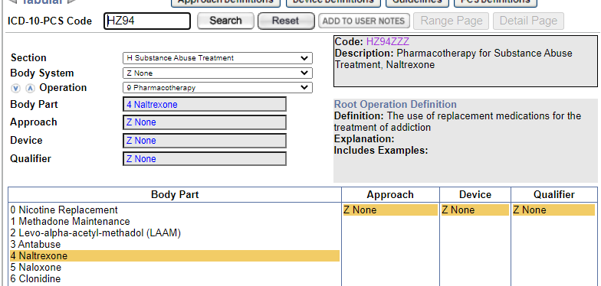
Clinical Example
Naltrexone treatment for drug dependency ?
ANS:HZ94ZZZ

Slide 8
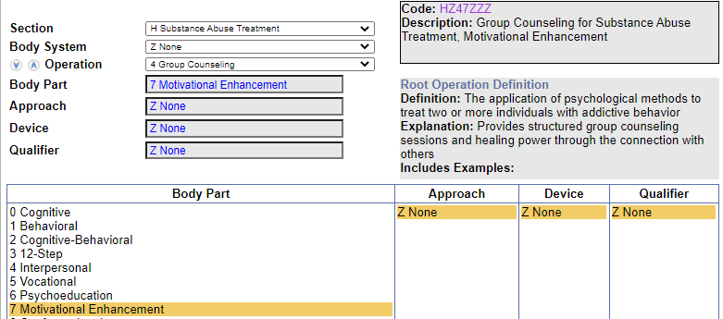
Clinical Example
Group motivational councelling ?
ANS: HZ47ZZZ

Slide 9
Knowledge check
Post test infectious disease councelling for IV drug abuser?
Individual 12-step psychotherapy for substance abuse?
Patient is on Alcohol detoxification treatment ?
ANS:???????

Slide 10
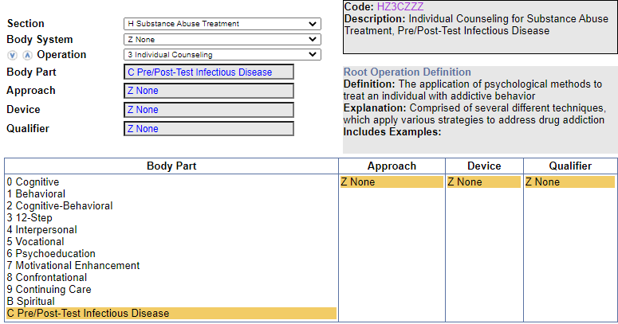
Ans:HZ3CZZZ, HZ53ZZZ,HZ2ZZZZ

Slide 11
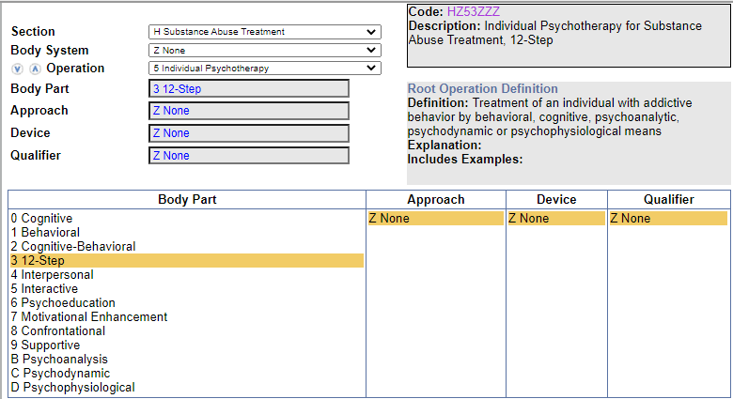
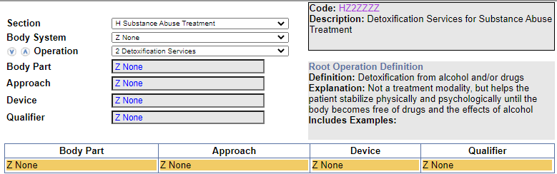

Slide 12
Thank you

